Slide 1



JS CrashCourse
JavaScript
Session2
Presented by Eng. Ramy Ibrahim
+20 10 928 128 48– ramymibrahim@yahoo.com

Slide 2
Course OUTLINES
Basic concepts
Basic Programming Concepts
JS Basic Syntax
Control Statements
Objects
Arrays
DOM & BOM
Variable Scope and Hoisting
OOP
Prototypes
Closures
Call backs and Async programming
Adv topic

Slide 3
Today’s outlines
How web works
What is Client ?
What is Server ?
Browser Components
Dynamic vs Static type
Interpretation vs Compilation
What is JavaScript ?
JS as Backend
Hello world
Variables
Data types
Primitive vs Reference types
Script tag
Make it = 2 Task

Slide 4
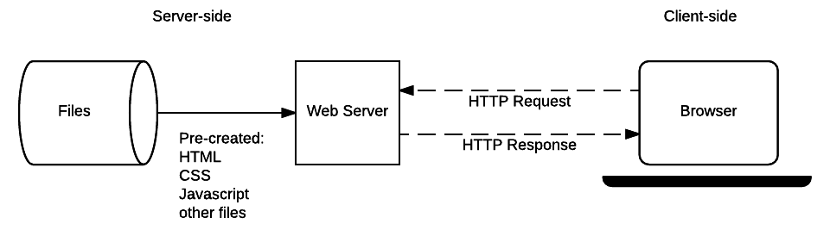
How web works
The complete story

Slide 5
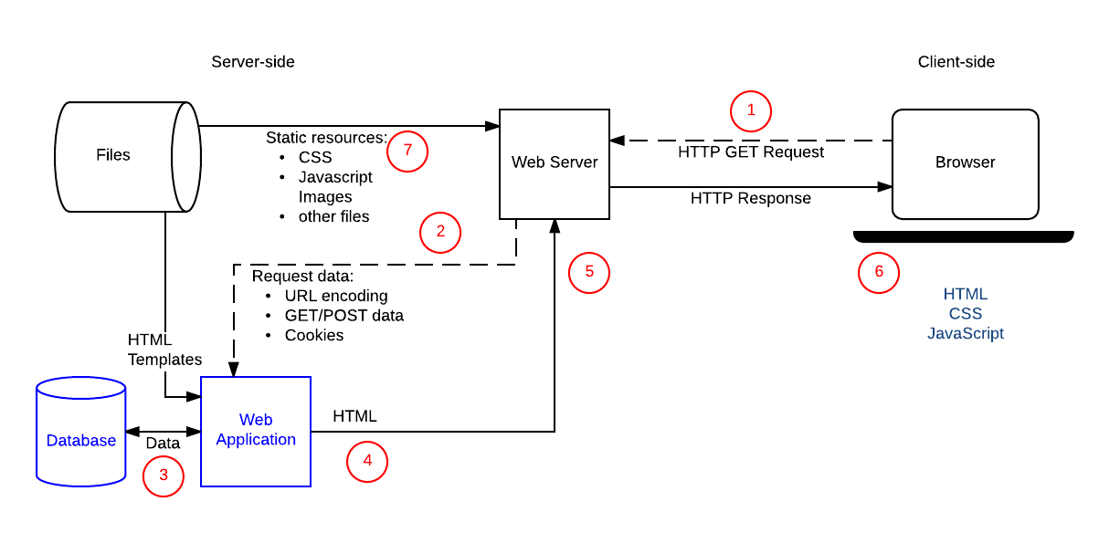
How web works
Complete story
Client – Server architecture
Protocols
URL
Methods

Slide 6
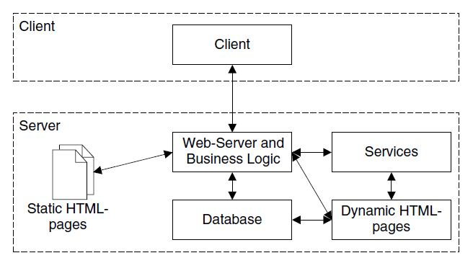
What is Client / Server

Slide 7

Browser Components

Slide 8
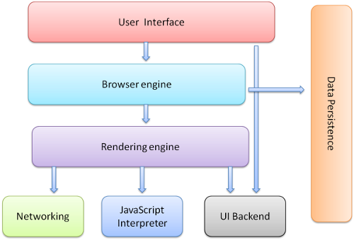
Browser Components

Slide 9
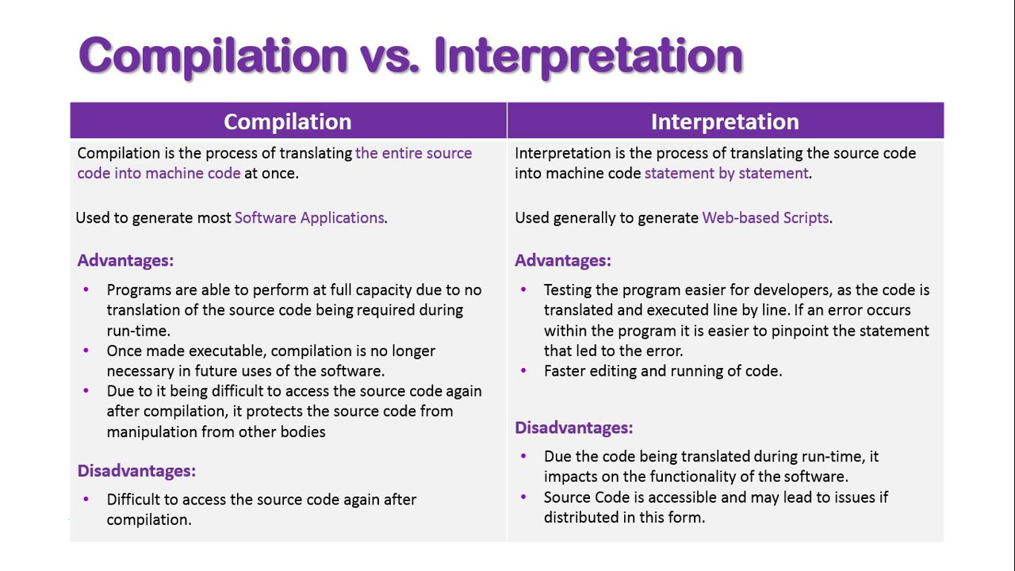
Compilation vs. Interpretation

Slide 10
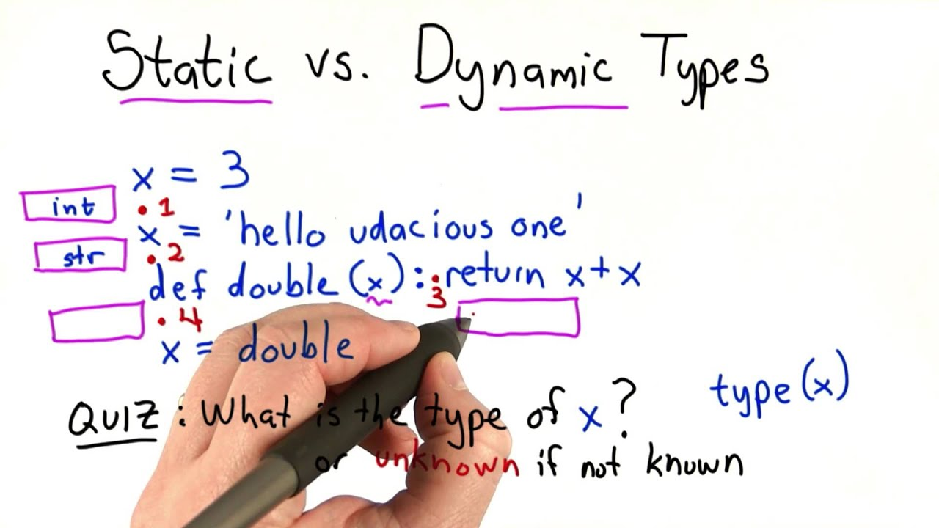
Dynamic vs Static type

Slide 11
What is JavaScript

Slide 12
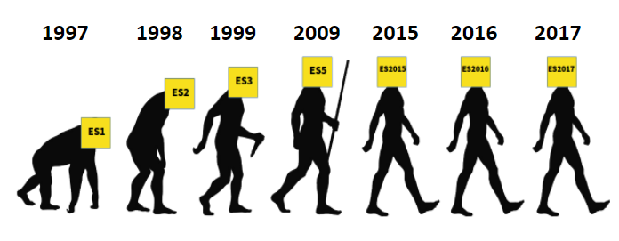

ECMA Script
ES2015 | 6
ES2016 | 7
ES2017 | 8
ES2018 | 9
ES2019 | 10
ES2020 | 11
ES2021 | 12
European Computer Manufacturers Association (ECMA)

